Slide 1

STALLION SYSTEMS AND SOLUTIONS PVT. LTD. - INDIA
STALLION SYSTEMS FZE - UAE
GLOBAL STALLION SYSTEMS LLC - UAE
GLOBAL STALLION SYSTEMS WLL - QATAR
RFID Based Supply Chain Management System
From garment factory, to warehouse, to store

Slide 2


Slide 3




ERP Integration
Private and Confidential

Slide 4

Our Reach – 18 Branch Across India & UAE
Delhi | Mumbai | Bangalore | Chennai | Hyderabad | Ahmedabad Kolkata | Kochi | Coimbatore | Madurai | Pune | Silvassa | Chandigarh | Trivandrum | Alleppey | Thrissur | Calicut | Kannur
Private and Confidential

Slide 5
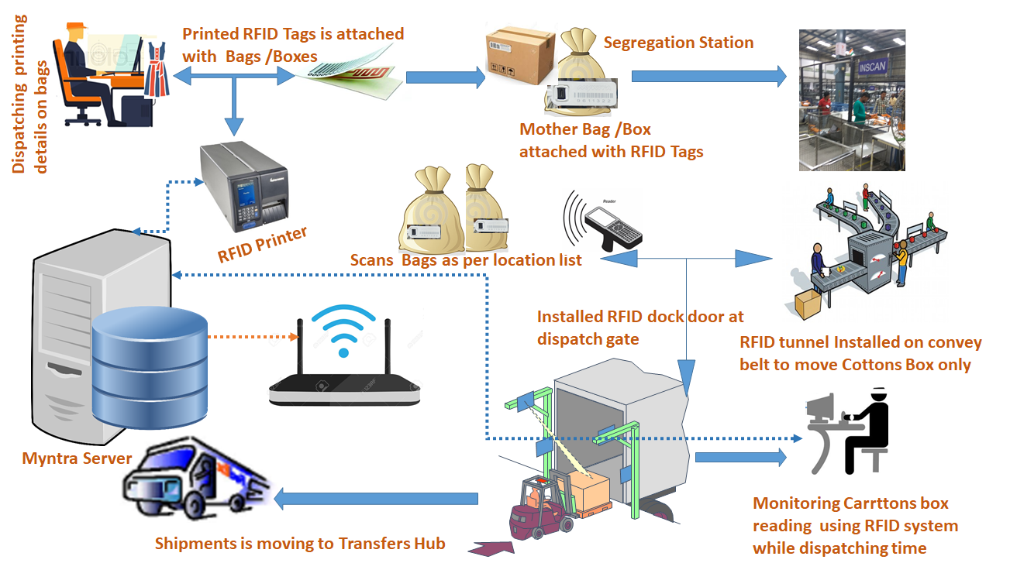
  Solutions Overview

Slide 6

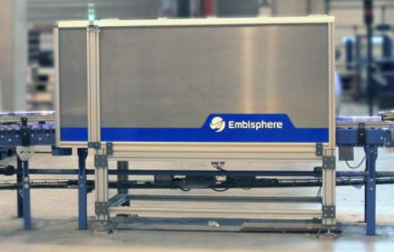
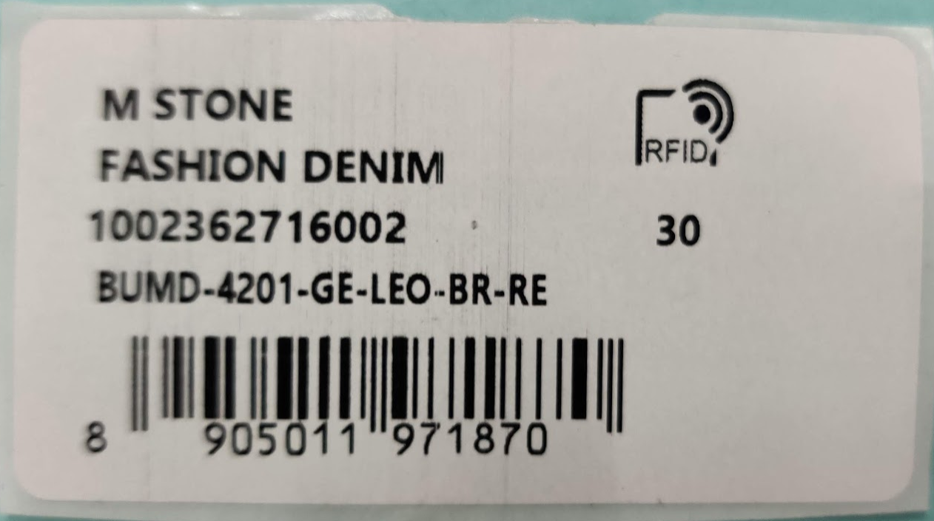
RFID @ Garment factory
Process overview
Attach RFID tags to garments at packing stage
Put packed & boxed garments through RFID tunnel reader
Instantly verify items basis quantity and SKU codes for dispatch
1
2
3
Shipment verification for dispatch no 12345
SKU Code | Planned | Actual | Difference
123456781 | 5 | 3 | -2
123456782 | 10 | 14 | 4
123456783 | 15 | 15 | 0
123456784 | 10 | 9 | -1
123456785 | 5 | 5 | 0
123456786 | 5 | 5 | 0
123456787 | 10 | 12 | 2

Slide 7

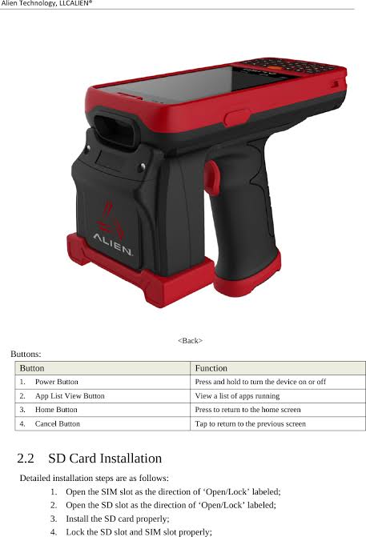

RFID @ Warehouse
IN warding
Process overview
1
Put packed & boxed garments through RFID tunnel reader
2
Instantly verify items basis quantity and SKU codes for inwarding & assign a time stamp for picking one FIFO basis
Shipment verification for dispatch no 12345
SKU Code | Planned | Actual | Difference
123456781 | 5 | 3 | -2
123456782 | 10 | 14 | 4
123456783 | 15 | 15 | 0
123456784 | 10 | 9 | -1
123456785 | 5 | 5 | 0
123456786 | 5 | 5 | 0
Stock statement - warehouse
SKU Code | EPC – SGTIN 96 bits | Timestamp (ddmmyyymmss) | Status | Location
123456781 | 30361F84D843A94000000001 | 011020191845 | Packed | 4A
 | 30361F84D843A94000000002 | 121020190930 | Racked | 2A
 | 30361F84D843A94000000003 | 301020192330 | Racked | 2B
123456782 | 30361F84D81C994000000001 | 050620191030 | Packed | 4C
 | 30361F84D81C994000000002 | 100620191345 | Packed | 4D
 | 30361F84D81C994000000003 | 300620191945 | Packed | 4E
Racking
1
- Load pack list from ERP
- Select SKU
2
- Scan rack barcode
- Select ‘rack tag’ option, put garment close to handheld reader
- Assign garment to rack location
Note: Development rqd
Pick list for box no 12345
SKU Code | Quantity
123456781 | 20
123456782 | 20
123456783 | 40
123456784 | 20
Pick list for box no 12345
SKU Code | Quantity
123456781 | 20
123456782 | 20
123456783 | 40
123456784 | 20

Slide 8




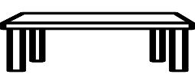

RFID @ Warehouse
Picking & Packing
Process overview
1
- Load pick list from ERP
- Select SKU
2
Select ‘find tag’ option
Note: Development rqd
3
Place garments in box
Pick list for box no 12345
SKU Code | Quantity
123456781 | 20
123456782 | 20
123456783 | 40
123456784 | 20
Pick list for box no 12345
SKU Code | Quantity
123456781 | 20
123456782 | 20
123456783 | 40
123456784 | 20
Complete packing by verifying quantity at reading station
4
Dispatch
Select ‘find tag’ option
Note: Development rqd
Put box through tunnel reader (optional) & verify garments being dispatched
1
- Load dispatch list from ERP
- Select box number
Assumes boxes are RFID tagged
2
3
Dispatch list for 12/12/2019
Box Number | No of garments
123456781 | 60
123456782 | 80
123456783 | 70
123456784 | 100
Dispatch list for 12/12/2019
Box Number | No of garments
123456781 | 60
123456782 | 80
123456783 | 70
123456784 | 100

Slide 9

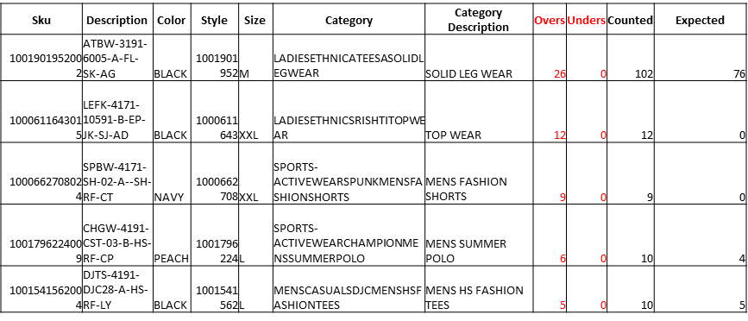

RFID @ Store
Process overview
Shipment receiving
1
Load ASN/inward list
Select Box number/ASN Number
2
Scan goods using handheld reader to verify quantity & place goods in ‘back of house’ (BOH) inventory
Inward list for store no 1234
ASN Number | Date
123456781 | 10/12/2019
123456782 | 10/12/2019
123456783 | 10/12/2019
123456784 | 11/12/2019
Inward list for store no 1234
ASN Number | Date
123456781 | 10/12/2019
123456782 | 10/12/2019
123456783 | 10/12/2019
123456784 | 11/12/2019
Stock statement – store no 12345
SKU Code | EPC – SGTIN 96 bits | Timestamp (ddmmyyymmss) | Location
123456781 | 30361F84D843A94000000001 | 101220190931 | BOH
 | 30361F84D843A94000000002 | 101220190931 | BOH
 | 30361F84D843A94000000003 | 101220190931 | BOH
123456782 | 30361F84D81C994000000001 | 101220190933 | BOH
 | 30361F84D81C994000000002 | 101220190933 | BOH
 | 30361F84D81C994000000003 | 101220190933 | BOH
1
Stock take
Select category/section of store to be scanned
Start scanning garments

Slide 10
RFID @ Store
Process overview
Replenishment
1
Perpetual inventory will be updated through sales & movement of goods from BOH to shop floor
Accordingly, when goods are below their set shelf capacity, a replenishment notification will be sent to store manager
Select ‘find tag’ option
Note: Development rqd
2
Update location of garment to the ‘shop floor’
3

Slide 11



RFID Middleware
High level integration with ERP
RFID Tag
RFID Reader
STA Database
ERP Database
Reporting to customer
1
2
3
4
Shipment verification for dispatch no 12345
SKU Code | Planned | Actual | Difference
123456781 | 5 | 3 | -2
123456782 | 10 | 14 | 4
123456783 | 15 | 15 | 0
123456784 | 10 | 9 | -1
123456785 | 5 | 5 | 0
123456786 | 5 | 5 | 0
123456787 | 10 | 12 | 2
Reader → STA DB Options:
We will store data on a cloud server dedicated to client
STA DB → ERP Options:
API Integration with cloud server
Daily file drop & upload on cloud server
Final decision will be as per mutual convenience

Slide 12
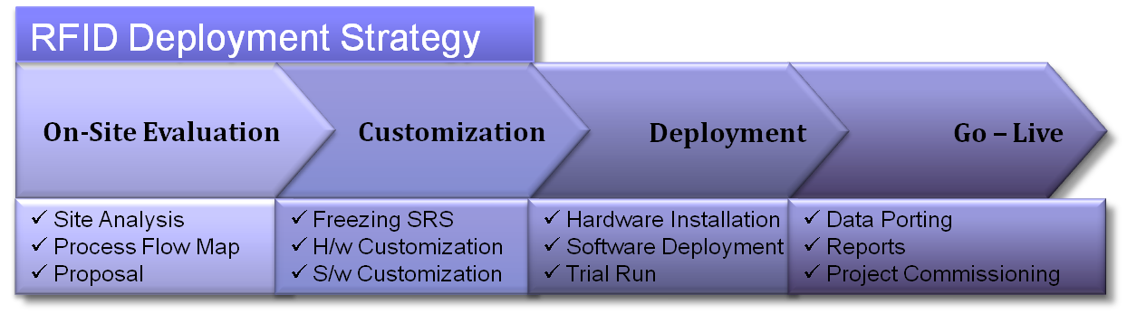
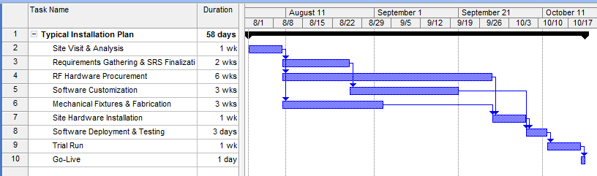
Implementation - Methodology
Sample Project Plan

Slide 13




Client List
Kenny’s Trend (Africa)
Bafena Classic
Chitradurga

Slide 14
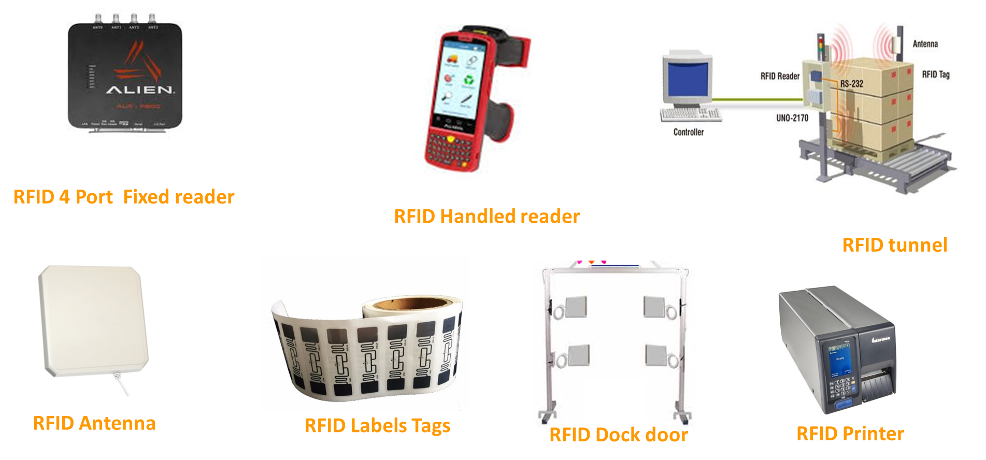
  Proposed hardware's

Slide 15

  Technology Partners

Slide 16
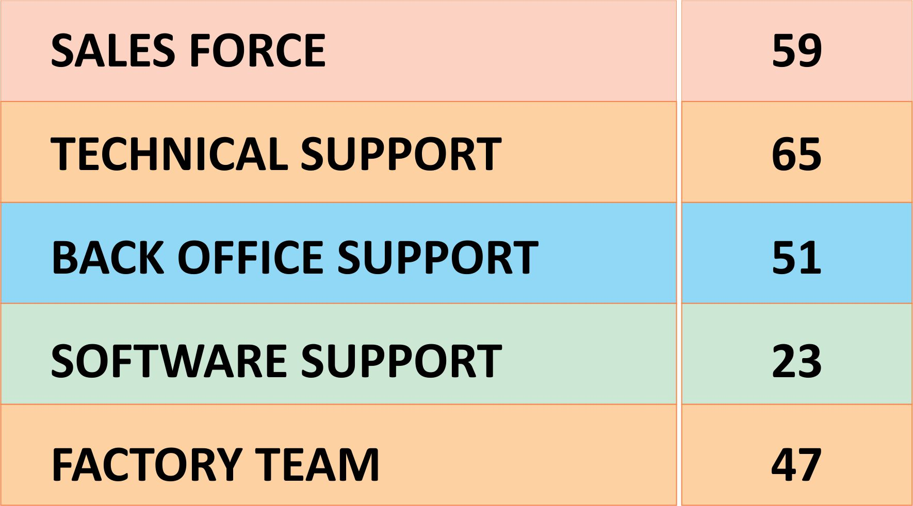
OUR STRENGTH :
245 DEDICATED MEMBERS

Slide 17
Customer Support – Escalation Matrix
  Goal: To Improve Your Working Relationship With Support and Take the Most of it
Branch Head
&
General Manager
Asst. General Manager- Technical
Manager – Technical Support
Technical Support

Slide 18
Thank you !

